Slide 1
Chapter 2 – Database System Concepts and Architecture

Slide 2
- Data Model, Schema and Instance
- Three schema architecture and data independence
- Database languages & Interfaces
- Database systems environment
- Classification of DBMS
Content

Slide 3
Data Models, Schemas, and Instances
Data abstraction: suppression of details of data organization and storage to highlight essential features.
A data model—a collection of concepts that can be used to describe the structure (data types, relationships, and constraints) of a database to achieve abstraction.
Data Models can be divided into 2 major categories:
High Level/Conceptual Data Model: provide concepts so that users can easily perceive data. (Example: ER Model)
Low Level/Physical Data Model: details on how data is stored on the computer storage media, typically magnetic disks.

Slide 4
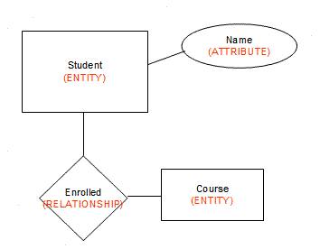
Data Models, Schemas, and Instances
Categories of Data Models:
High-level or conceptual data models such as entity–relationship model provide concepts that are easy for users to understand.
Conceptual data models use concepts such as entities, attributes, and relationships.
An entity represents a real-world object or concept, such as a student or a course.
An attribute further describes an entity, such as the student’s name or age.
A relationship among two or more entities represents an association among the entities, for example, a student is enrolled in a course.
Physical data models describe how data is stored as files in the computer by representing information such as record formats, record orderings, and access paths.

Slide 5
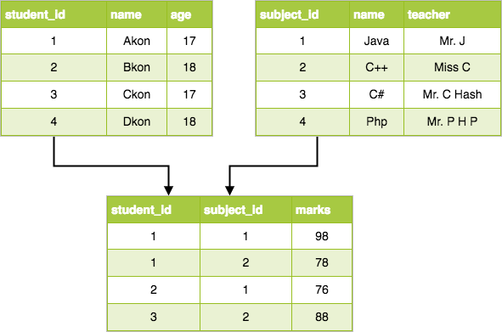
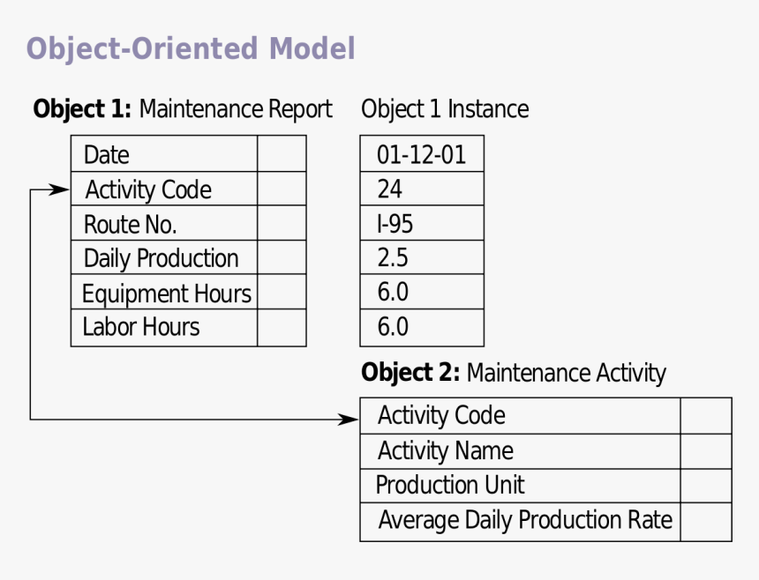
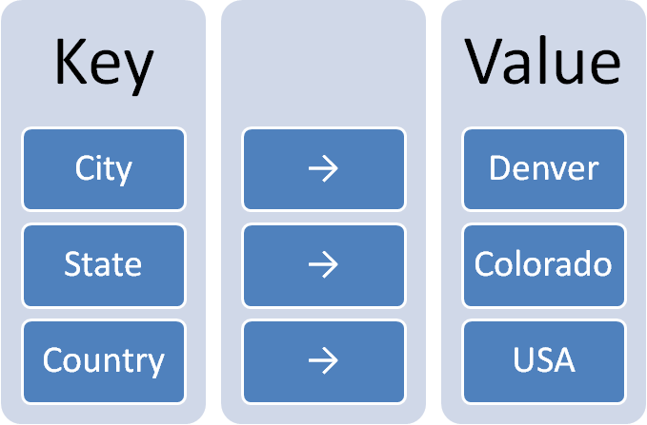
Data Models, Schemas, and Instances
Representational or implementation data models are used most frequently in traditional commercial DBMSs. These include the widely used relational data model.
Object data model is an example of a higher-level implementation data model that is closer to conceptual data models.
Self-describing data models - The data storage in these models combines the description of the data with the data values. These models include XML, key-value stores, and NOSQL systems

Slide 6
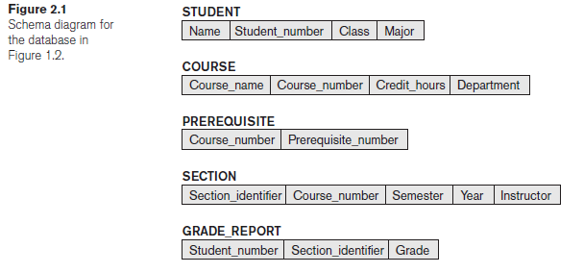
Data Models, Schemas, and Instances
Schemas, Instances, and Database State
The description of a database is called the database schema, which is specified during database design.
A displayed schema is called a schema diagram shown in Figure 2.1. The diagram displays the structure of each record type but not the actual instances of records.
Each object in the schema—such as STUDENT or COURSE— a schema construct.
Other aspects such as the data type of each data item nor the relationships among the various files are not specified.

Slide 7
Data Models, Schemas, and Instances
Schemas, Instances, and Database State
The actual data in a database may change quite frequently. For example, the database changes every time we add a new student or enter a new grade.
The data in the database at a particular moment in time is called a database state or snapshot or current set of occurrences/instances in the database.
Difference between database schema and database state.
When we define a new database, we specify its database schema only to the DBMS. At this point, the database state is the empty state.
Initial state - when the database is first populated with the initial data. From then on, every time an update operation is applied, we get another database state. At any point in time, the database has a current state.
Valid state—that is, a state that satisfies the structure and constraints specified in the schema.

Slide 8
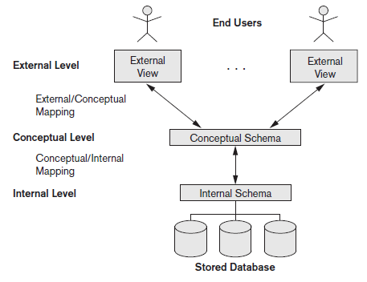
Three schema architecture and data independence
The Three-Schema Architecture
The goal of the three-schema architecture is to separate the user applications from the physical database.
Internal Level - The internal level has an internal schema, which describes the physical storage structure of the database.
  The internal schema uses a physical data model and describes the complete details of data storage and access paths for the database.
Conceptual level - The conceptual level has a conceptual schema, which describes the structure of the whole database.
  The conceptual schema hides the details of physical storage structures and concentrates on describing entities, data types, relationships, user operations, and constraints.
External level - The external or view level includes a number of external schemas or user views.
  Each external schema describes the part of the database that a particular user group is interested in and hides the rest of the database from that user group.
The three schemas are only descriptions of data; the actual data is stored at the physical level only.

Slide 9
Three schema architecture and data independence
The Three-Schema Architecture
Request specified
on an external schema
The processes of transforming
requests and results between levels are called mappings.
Request transformed into conceptual schema
Request transformed into internal schema
Processing

Slide 10
Three schema architecture and data independence
Data Independence
Data independence – the capacity to change the schema at one level of a database system without having to change the schema at the next higher level.
Logical data independence is the capacity to change the conceptual schema without having to change external schemas . We may change the conceptual schema (by adding a record type or data item), to change constraints, or to reduce the database (by removing a record type or data item).
After the conceptual schema changes, application programs that reference the external schema constructs must work as before.
Changes to constraints can be applied to the conceptual schema without affecting the external schemas or application programs.

Slide 11
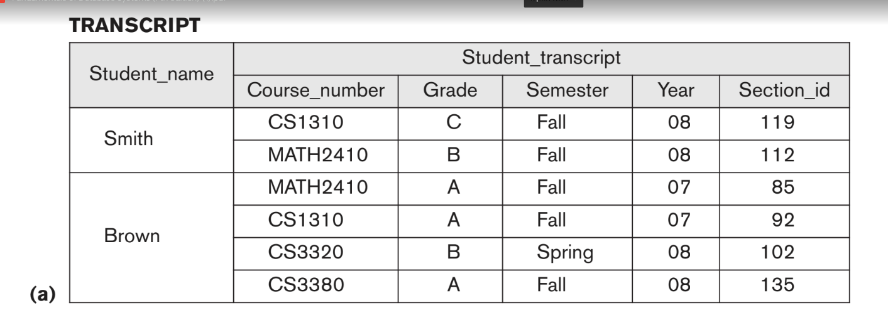
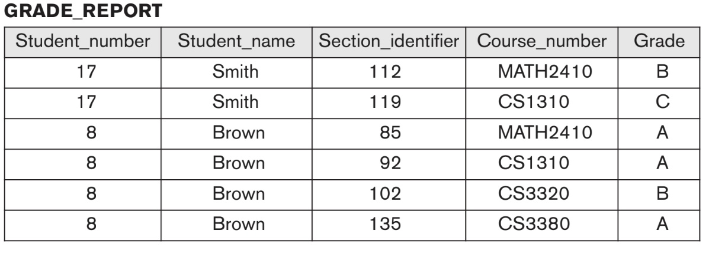
Three schema architecture and data independence
Only view definition and mappings are changed.

Slide 12
Three schema architecture and data independence
Data Independence
Physical data independence is the capacity to change the internal schema without having to change the conceptual schema. Hence, the external schemas need not be changed as well.
Changes to the internal schema may be needed because some physical files were reorganized—for example, by creating additional access structures—to improve the performance of retrieval or update.
If the same data as before remains in the database, we should not have to change the conceptual schema.
Which data independence is harder to achieve? Physical or logical? Why?
Logical is hard to achieve since applications are heavily dependent on data. Physical independence such as access paths, compression techniques, encoding is already handled by the OS.

Slide 13
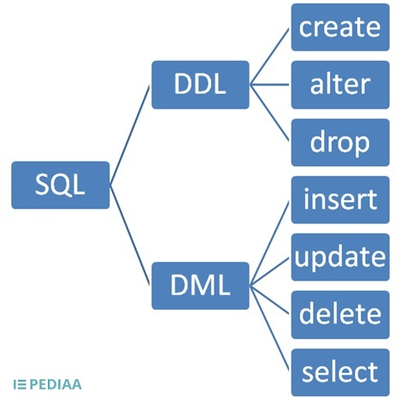
Database Languages and Interfaces
DBMS Languages
Data definition language (DDL) - is used to specify conceptual and internal schemas for the database.
The DBMS will have a DDL compiler whose function is to process DDL statements to identify descriptions of the schema constructs and to store the schema description in the DBMS catalog.
DDL is used to specify the conceptual schema only. Another language, the storage definition language (SDL), is used to specify the internal schema (depending on DBMS used).

Slide 14
Database Languages and Interfaces
DBMS Languages
Typical manipulations include
  Retrieval,
  Insertion,
  Deletion,
  Modification of the data.
The DBMS provides a set of operations called the data manipulation language (DML).
There are two main types of DMLs.
  A high-level or nonprocedural DML can be used to specify complex database operations that can be carried out directly from a terminal.
  A low level or procedural DML must be embedded in a general-purpose programming language. It retrieves individual records or objects from the database and processes each separately. (JAVA)

Slide 15
Database Languages and Interfaces
DBMS Interfaces
Menu-based Interfaces for Web Clients or Browsing. These interfaces present the user with lists of options (called menus) that lead the user through the formulation of a request. The query is composed step-by- step by picking options from a menu displayed by the system.
Apps for Mobile Devices. These interfaces present mobile users with access to their data. For example, banking, reservations, and insurance companies, provide apps that allow users to access their data through a mobile phone.
Forms-based Interfaces. A forms-based interface displays a form to each user. Users can fill out all of the form entries to insert new data.
Graphical User Interfaces. A GUI typically displays a schema to the user in diagrammatic form. The user then can specify a query by manipulating the diagram. In many cases, GUIs utilize both menus and forms.

Slide 16
Database Languages and Interfaces
DBMS Interfaces
Natural Language Interfaces. These interfaces accept requests written in English or some other language and attempt to understand them. A natural language interface usually has its own schema, which is similar to the database conceptual schema, as well as a dictionary of important words.
  Example: Show me a list of all the customers in my database = Select CustomerID from Customers
Keyword-based Database Search. These are somewhat similar to Web search engines, which accept strings of natural language (like English) words and match them with documents at specific sites (for local search engines) or Web pages on the Web at large (for engines like Google or Ask).
Speech Input and Output. Applications with limited vocabularies, such as inquiries for telephone directory, flight arrival/departure, and credit card account information, are allowing speech for input and output to enable customers to access this information.
Interfaces for Parametric Users. Parametric users, such as bank tellers, often have a small set of operations that they must perform repeatedly.
  For example, a teller is able to use single function keys to invoke routine and repetitive transactions such as account deposits or withdrawals, or balance inquiries.

Slide 17
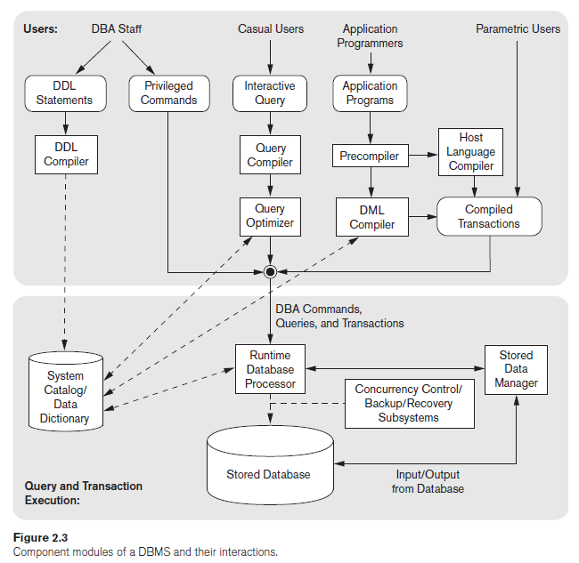
The Database System Environment
DBMS Component Modules
Top part of the figure refers to the various users of the database environment and their interfaces.
Lower part shows the internal modules of the DBMS responsible for storage of data and processing of transactions.
The database and the DBMS catalog are usually stored on disk. Access to the disk is controlled primarily by the operating system (OS), which schedules disk read/write.

Slide 18
The Database System Environment
DBMS Component Modules
USERS (top part)
Interfaces for the DBA staff
Casual users who work with interactive interfaces to make queries
Application programmers who create programs using some host programming languages
Parametric users who do data entry work by supplying parameters to predefined transactions.
  Querying and updating the database, using standard types of queries and updates called canned transactions—that have been carefully programmed and tested.
  Bank customers and tellers check account balances, Reservation agents for airlines, hotels, and car rental companies to make reservations.
  Social media users post and read items on social media Web sites.
  Sophisticated end users include engineers, scientists, business analysts and so on

Slide 19
The Database System Environment
DBMS Component Modules
DBA Staff
Works on defining the database and tuning it by making changes to its definition using DDL and other privileged commands.
DDL compiler - processes schema definitions, specified in DDL and stores descriptions of the schemas (meta-data) in the DBMS catalog.
Catalog includes information such as the
  names and sizes of files,
  names and data types of data items,
  storage details of each file,
  mapping information among schemas,
  and constraints.

Slide 20
The Database System Environment
DBMS Component Modules
Casual users
Interact using the interactive query interface for example any menu-based, form-based or mobile interactions.
Query compiler - queries are parsed and validated for correctness, the names of files and data elements, and so on by a query compiler that compiles them into an internal form. This internal query is subjected to query optimization.
Query optimizer- concerned with the possible reordering of operations, elimination of redundancies, and use of efficient search algorithms during execution.
  Consults the system catalog for physical information about the stored data.
  Generates executable code that performs the necessary operations for the query and makes calls on the runtime processor.

Slide 21
The Database System Environment
DBMS Component Modules
Application programmers
Write programs in host languages such as Java, C, or C++ that are submitted to a precompiler.
Precompiler - extracts DML commands from an application program written in a host programming language.
  Commands are sent to the DML compiler for compilation into object code for database access. The rest of the program is sent to the host language compiler.
The object codes for the DML commands and the rest of the program are linked, forming a canned transaction whose executable code includes calls to the runtime database processor.
Each execution is considered to be a separate transaction.
  An example is a bank payment transaction where the account number, payee, and amount may be supplied as parameters.

Slide 22
The Database System Environment
DBMS Component Modules
QUERY AND TRANSACTION EXECUTION (lower part)
Runtime database processor
  executes privileged commands,
  executes the executable queries,
  executes the canned transactions with runtime parameters.
  Works with the system catalog.
  Works with the stored data manager, which in turn uses basic operating system services for carrying out low-level input/output (read/write) operations between the disk and main memory.
  Concurrency control/Backup/Recovery systems integrated into the working of the runtime database processor for purposes of transaction management

Slide 23
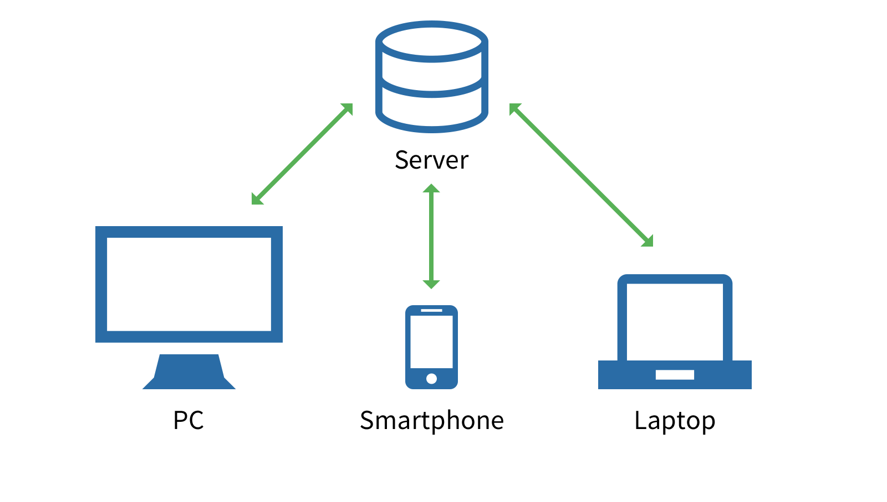
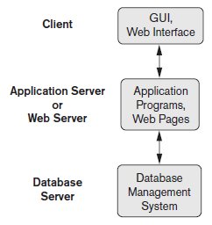
The Database System Environment
DBMS Component Modules
It is common to have the client program that accesses the DBMS running on a separate computer or device from the computer on which the database resides.
The former is called the client computer running DBMS client software and the latter is called the database server.
In many cases, the client accesses a middle computer, called the application server, which in turn accesses the database server.

Slide 24
The Database System Environment
Database System Utilities
Most DBMSs have database utilities that help the DBA manage the database system.
Loading - used to load existing data files—such as text files or sequential files—into the database. Usually, the current (source) format of the data file and the desired (target) database file structure are specified to the utility.
Backup - creates a backup copy of the database, usually by dumping the entire database onto tape or other mass storage medium.
  The backup copy can be used to restore the database in case of catastrophic disk failure. Incremental backups are also often used, where only changes since the previous backup are recorded.
Database storage reorganization - used to reorganize a set of database files into different file organizations and create new access paths to improve performance.
Performance monitoring - monitors database usage and provides statistics to the DBA.
Other utilities may be available for sorting files, handling data compression, monitoring access by users, and performing other functions.

Slide 25
Classification of Database
Management Systems
Several criteria can be used to classify DBMSs.
  Data model on which the DBMS is based
  Number of users supported by the system
  Number of sites over which the database is distributed
  Cost
  Types of access path
  Types of DBMS
1. Data model
Main data model used widely is the relational data model and the systems based on this model are known as SQL systems.
Object data model has been implemented in some commercial systems but has not had widespread use.
Recently, so-called big data systems, also known as key-value storage systems and NOSQL systems, use various data models: document-based, graph-based, column-based, and key-value data models.
Some experimental DBMSs are based on the XML (eXtended Markup Language) model, which is a tree-structured data model.

Slide 26
Classification of Database
Management Systems
2. Number of users
Single-user systems support only one user at a time and are mostly used with PCs.
Multiuser systems, which include the majority of DBMSs, support concurrent multiple users.
3. Number of sites
A DBMS is centralized if the data is stored at a single computer site. A centralized DBMS can support multiple users, but the DBMS and the database reside at a single computer site.
A distributed DBMS (DDBMS) can have the actual database and DBMS software distributed over many sites connected by a computer network.
4. Cost
It is difficult to propose a classification of DBMSs based on cost.
Open source (free) DBMS products like MySQL and PostgreSQL that are supported by third-party vendors with additional services.
Some license limits the number of concurrent users or the number of user seats at a location.
Standalone single-user versions of some systems like Microsoft Access are sold per copy or included in the overall configuration of a desktop or laptop.

Slide 27
Classification of Database
Management Systems
5. Types of access path
Options used for storing files.
6. Types of DBMS
A DBMS can be general purpose or special purpose.
When performance is a primary consideration, a special-purpose DBMS can be designed and built for a specific application; such a system cannot be used for other applications without major changes.
Many airline reservations and telephone directory systems developed in the past are special-purpose DBMSs. These fall into the category of online transaction processing (OLTP) systems, which must support a large number of concurrent transactions.

